Slide 1
Selection of a novel mine tracer gas for assessment of ventilation systems in underground mines
Susanne Underwood, Rosemary Patterson,
Kimberly Jackson, Kray Luxbacher, Harold McNair

Slide 2

Acknowledgements
This publication was developed under Contract No. 200-2009-31933, awarded by the National Institute for Occupational Safety and Health (NIOSH). The findings and conclusions in this report are those of the authors and do not reflect the official policies of the Department of Health and Human Services; nor does the mention of trade names, commercial practices, or organizations imply endorsement by the U.S. Government.
Notes:
Inaccessible to personnel

Slide 3
Outline
Background
Application
Summary
Results of tracer analysis
Future work
Ventilation surveys using trace analysis
Conclusions
Tracer characteristics
Previous uses of considered tracer elements
Development of analysis method
Selection of a tracer element

Slide 4
Background
  Project Objective
To select a safe novel tracer
Novel tracer must have similar sensitivity to current tracers
Develop one analysis method to allow for concurrent deployment of tracers

Slide 5
Background
  Tracer Technique
Directly measures air quantity
When traditional point measurement of velocity cannot be used including
  Where cross-sectional area cannot be easily measured
  Locations deemed unsafe due to emergency
  Places with very low or irregular flow
Notes:
Inaccessible to personnel

Slide 6
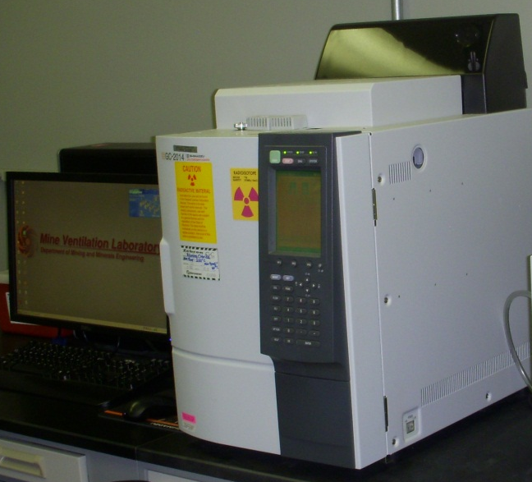
Background
  How does the tracer technique work?
Tracer is directly released into atmosphere
Gas chromatography analysis
Two methods
  Continuous tracer release
  Pulse tracer release
Limited applications due to time
Notes:
Calculations based off of tracer feed rate and concentration

Slide 7
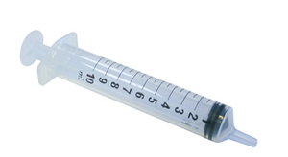
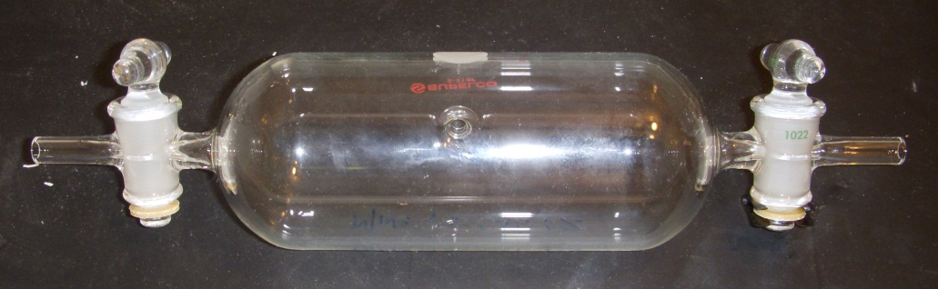
Background
  How will a novel tracer help?
Increase ventilation survey versatility
Simultaneous analysis of airways/leakages
Reduces the time limitations of traditional tracer analysis

Slide 8
Background
  Tracer Requirements
Easily detected and analyzed
Absent from mine air
Nonreactive, nontoxic, noncorrosive, nor explosive
Readily attainable
Easily transported
Highly sensitive

Slide 9
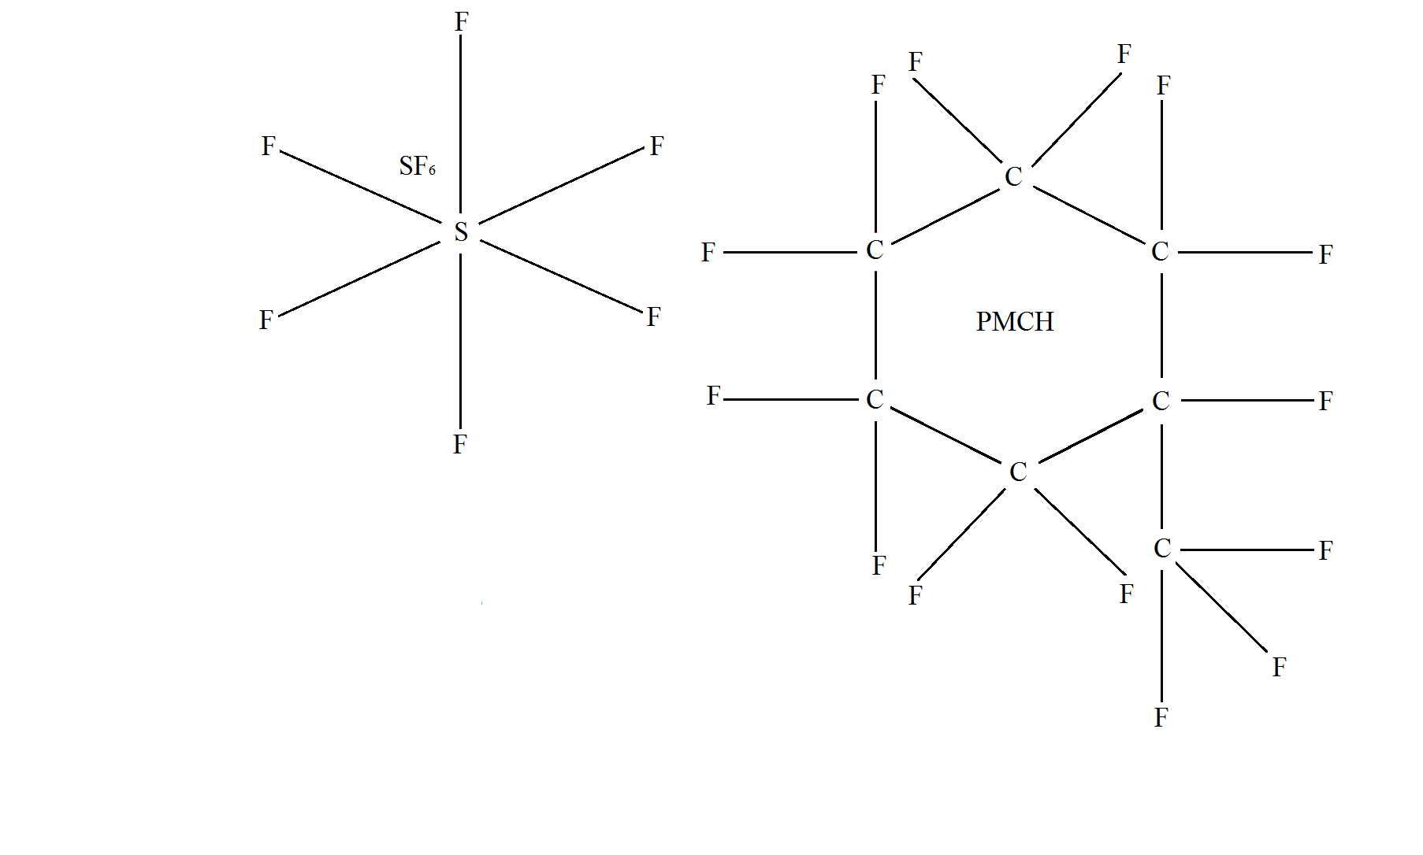
Background
  Tracers Considered
Industry standard is Sulfur Hexafluoride (SF₆)
Freons
  Carbon Tetrafluoride (CF₄)
  Octofluoropropane (C₃F₈)
Perfluorocarbon tracers
Notes:
Freons have been successfully used as mine tracers before, low molecular weights, readily available in compressed gas cylinders, fluorine compounds

Slide 10
Background
  Previous Tracer Applications
Freon testing in mines
Perfluorocarbon Tracers
  Urban environments
  European Tracer Experiment
  Oil and gas reservoirs
  Home ventilation systems
  No evidence that PFTs have been used in mines
Notes:
Nitrous oxide and helium have been used before, but they were mostly unsuccessful due to very low sensitivity.
Freon 13B1 and Freon 12 were tested by Kennedy. They were successful tracers for ventilation surveys, but we wanted to develop a simple method that could simultaneously analyze SF6 and another tracer employing a simple means of analysis. Therefore, for our purposes, freons were not found to be sensitive enough.
133 Xenon Gas was used as a tracer in abandoned mines by Wala. Requires another means of analysis, so unsuitable to our purposes.

Slide 11
Background
  PMCH Characteristics
C₇F₁₄
Volatile liquid
Boiling point of 67⁰C
Biologically inert
Molecular weight of 350 g/mol
Very low ambient backgrounds
Notes:
PMCH contains no unsaturated bonds so that it is extremely stable
146 is sf6 molecular weight
Ambient backgrounds of all PFTs is 0.03 PPT
Environmentally friendly – no reaction in the ozone
Specifically discuss what made PMCH a better tracer than the freons. Discuss the number of fluorines, as well as the molecular weight. Also a theat of presence of freons because of spray paint.

Slide 12
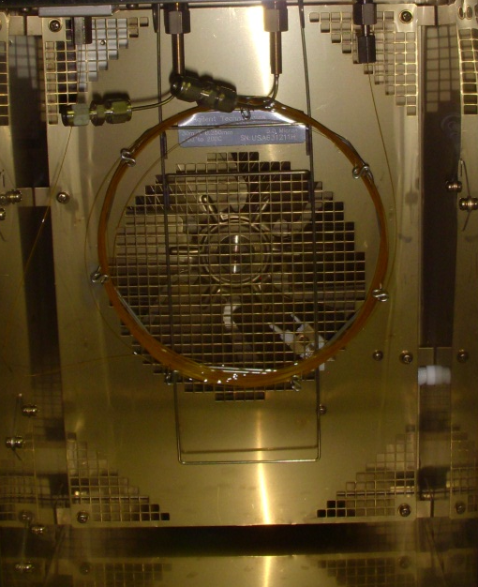
Application
  Experimental Design
Shimadzu 2014 Gas Chromatograph
Electron Capture Detector
Columns tested for Freons
  SBP-1 Sulfur
  ZB-624
  TG Bond Q+
  TG Bond Q
PMCH tested using HP-AL/S column
Notes:
The columns that were selected for testing were selected based on their stationary phases, which encourages separation of the analytes from one another during analysis. The affinity of each individual analyte for the selected stationary phase determines the degree, or lack of, separation that occurs.

Slide 13
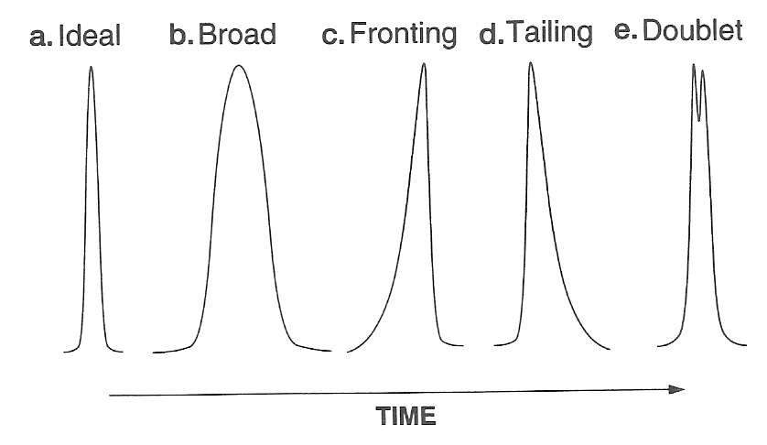
Application
  Goals
Achieve separation between peaks
Attain Gaussian shaped peaks
Apply an acceptable method

Slide 14
Notes:
This is a table displaying the average retention times of the experimental analytes on various columns at various temperatures.
The retention times are important for 2 primary reasons.
During development of methods and determining which gases would be viable tracers, retention times indicate separation.
Once a method is developed, retention times tell you what you are looking at. GCs are not capabale of telling you what you are looking at. They can only detect and quantify that something is present. Only a MS can tell you what you are looking at. Therefore, we use retention times to indicate what the sample is. Since we made pure injections of all of our analytes, we know that peaks that elute at those times are the analyte.
Oxygen is not an analyte, but air will always be present in samples, so we needed to ensure that we had separation there as well.

Slide 15
Notes:
The peak area is key. Peak area measurements allow for quantification of concentration. Calibration curves are developed because very slight variations in methodology will impact peak area results.

Slide 16
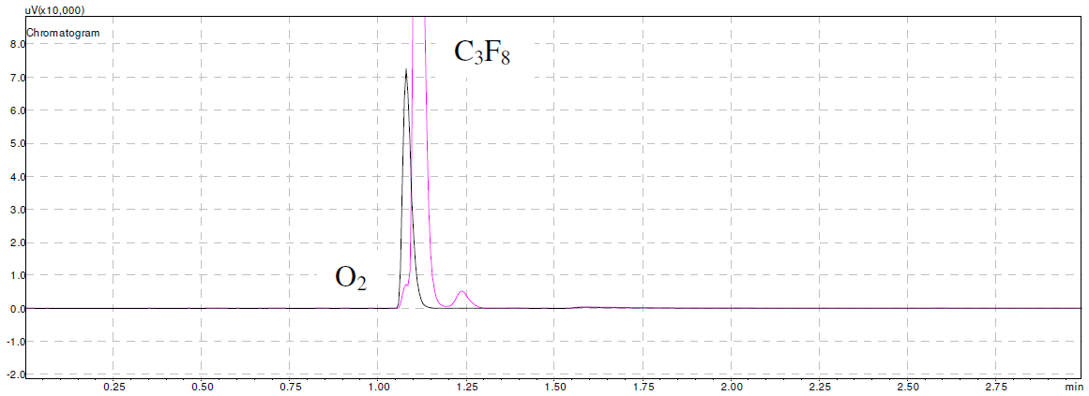
Application
  Chromatogram Results
µV(x10,000)
min
Notes:
Figure 2: Comparison of Syringe Blank (Black) and 10 µL Injection of Pure C₃F₈ at 20⁰C (Pink)

Slide 17
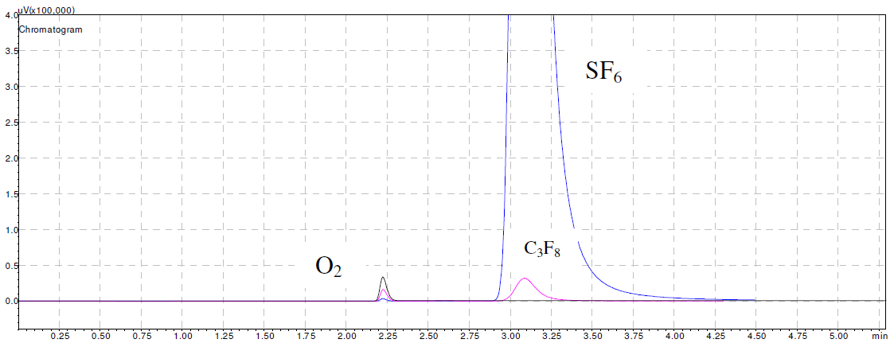
Application
  Chromatogram Results
µV(x100,000)
min
Notes:
Figure 3: Overlay of Syringe Blank (Black), 1 µL SF₆ Injection (Blue) and 10 µL C₃F₈ Injection (Pink)

Slide 18
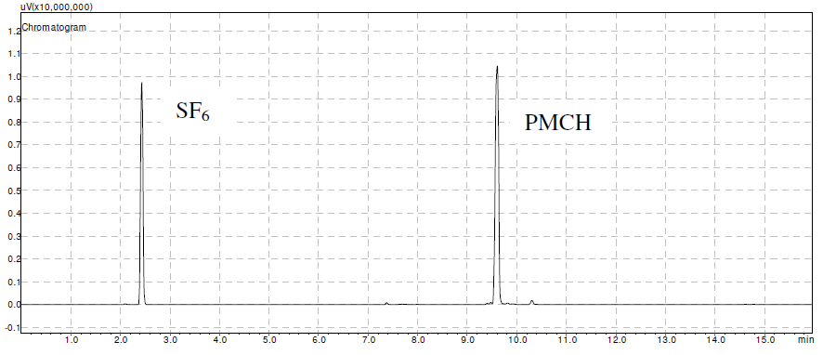
Application
  Chromatogram Results
µV(x10,000,000)
min
Notes:
Figure 4: 1 mL Injection of a Sample of 100 ppm SF₆ & PMCH in N₂
Provided are the specifications for the column and the developed method.
Here is a method we developed so that those using SF6 can adopt our method if they’d like to add a second tracer. The method can be easily replicated if someone already using SF6 as a tracer would like to introduce PMCH as a second tracer into their existing system.

Slide 19
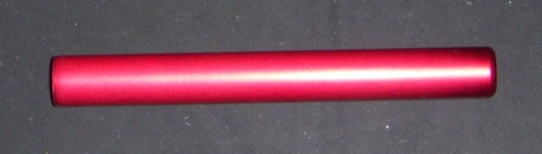
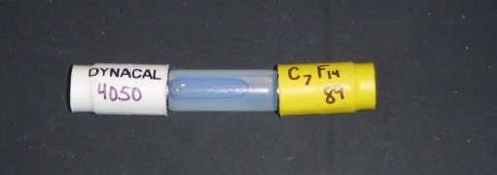
Summary
  Future Work
PMCH vulnerabilities to sample loss
Methods of release
  Permeation tubes
  Fluoroelastomer plug source
  Gas Cylinders

Slide 20
Summary
  Conclusions
Unsuccessful separation when using Freon gases
PMCH is a favorable tracer selection
  Successful separation
  Encouraging previous applications
A simple GC method has been developed

Slide 21
Summary
  Thank you
Questions?

